Slide 1

Anomaly Detection in Multivariate Time series Data using Transformer Network
Guide : Dr. Rahul Desai
Members
4410 Akash Singh
4420 Dipankar Kumar Singh
4428 Himanshu Yadav

Slide 2

Anomaly Detection in Multivariate Time series Data using Transformer Network

Slide 3
Abstract
Anomaly detection is examining specific data points and detecting rare occurrences that seem suspicious because they’re different from the established pattern of behaviors. Anomaly detection isn’t new, but as data increases manual tracking is impractical.

Slide 4

Introduction

Slide 5

multivariate time series data
Multivariate: There are multiple variables or features recorded simultaneously. For instance, in a manufacturing environment, variables could include temperature, pressure, and humidity, all recorded over time.
Time Series: Data is collected over a continuous or discrete period of time. Time series data implies that the values of the variables are recorded in a sequential order.

Slide 6

Data Set

Slide 7
Multiple Famous multivariate data set
Server Machine Dataset (SMD): SMD was published in 2019, which lasts for 5 weeks long, monitors 28 server machines for a large Internet company with 33 sensors. SMD is one of the largest public datasets currently available for evaluating multivariate time-series anomaly detection. It contains metrics like CPU load, network usage, memory usage, etc.
Soil Moisture Active Passive (SMAP) satellite and Mars Science Laboratory (MSL) rover Datasets: SMAP and MSL are two datasets published by NASA (2018). SMAP contains 55 entities, and each entity is monitored by 25 sensors. MSL contains 27 entities and 66 sensors for each entity. The metrics in the two datasets include telemetry data, radiation, temperature, power, computational activities, etc.

Slide 8
Water Distribution (WADI) dataset : This is an extension of the SWaT system, but had more than twice the number of sensors and actuators than the SWaT model. The dataset is also collected for a longer duration of 14 and 2 days of normal and attack scenarios
Multi-Source Distributed System (MSDS) Dataset: This is a recent high-quality multi-source data composed of distributed traces, application logs, and metrics from a complex distributed system. This dataset is specifically built for AI operations, including automated anomaly detection, root cause analysis, and remediation.

Slide 9

Methodology

Slide 10

Transformer Model
Transformers are popular deep learning models that have been used in various natural language and vision processing tasks
It is similar to Encoder-decoder models, in a transformer, an input sequence undergoes several attention-based transformations
The encoder encodes the complete sequence until the current timestamp 𝐶 with a focus score.

Slide 11
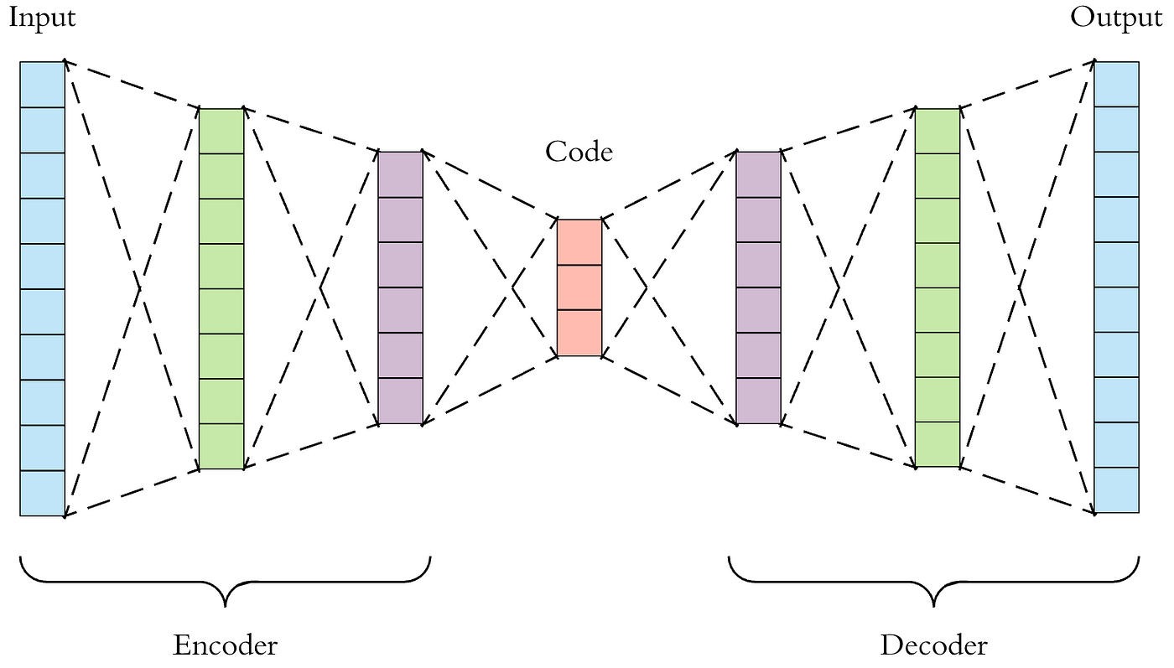
Encoder – Decoder Model

Slide 12

Positional Encoding
Positional encoding is a technique used in the field of natural language processing (NLP), particularly in the context of sequence-to-sequence models like transformers. In these models, the input sequences are typically processed as a set of tokens, without inherent ordering like in recurrent neural networks or convolutional neural networks.
However, since the order of tokens in a sequence carries important information, positional encoding is introduced to provide the model with information about the position of each token in the sequence. This helps the model differentiate between tokens based on their position and prevents the loss of positional information during processing.
Positional encoding is usually added to the input embeddings of tokens before feeding them into the transformer model. There are several ways to encode positional information, but a common method is to use sine and cosine functions with different frequencies and offsets. These functions generate a unique encoding for each position in the sequence, which is then added to the corresponding token embedding.

Slide 13
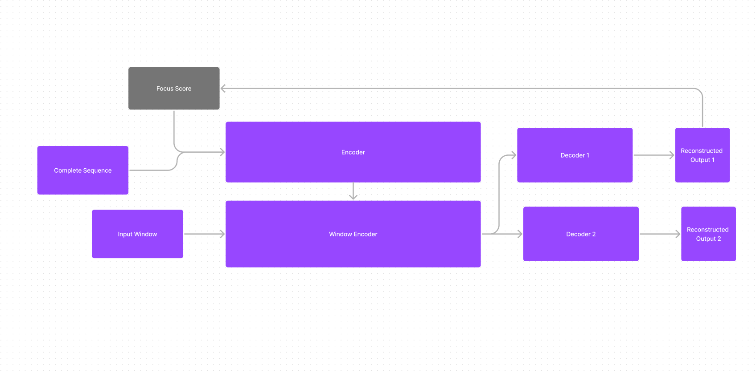
High Level Architecture Diagram

Slide 14
Offline Two-Phase Adversarial Training
Phase 1 - Input Reconstruction Phase 2 - Focused Input Reconstruction

Slide 15
Phase 1 - Input Reconstruction
The Transformer model enables us to predict the reconstruction of each input time-series window. It does this by acting as an encoder-decoder network at each timestamp. However, traditional encoder-decoder models often are unable to capture short-term trends and tend to miss anomalies if the deviations are too small

Slide 16

Phase 2 - Focused Input Reconstruction
In the second phase, we use the reconstruction loss for the first decoder as a focus score. The focus score generated in the first phase indicates the deviations of the reconstructed output from the given input. This acts as a prior to modify the attention weights in the second phase and gives higher neural network activation to specific input sub-sequences to extract short-term temporal trends.

Slide 17

Thank You

